Slide 1

Software Update
CC1310 Firmware and Python Code

Slide 2
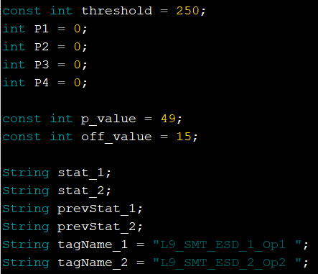
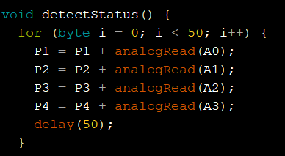
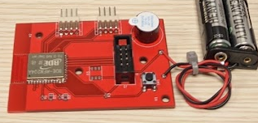
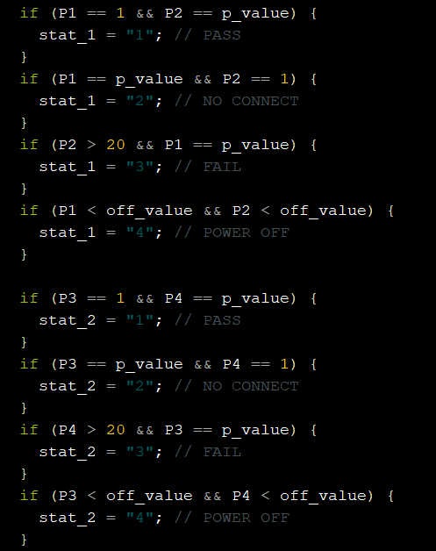
CC1310 two ESD Port
Assign variables
4 Analog Pins Assigned to
(A0, A1) and (A2, A3)
ESD Port 1
ESD Port 2

Slide 3
Recognizing ESD Tagname and its value
Scenario :
When multiple ESD, and wireless module is deployed in the shopfloor. The system will receive multiple result from unique sensor location.
Need to identify the unique value whenever there are changes in sensor value.
Obtain the unique data from web server and update SQL server.
Example :
Finding only ESD value on python
package = “L9_SMT_ESD_1_Op1 2L10_SMT_Humd_1_Op1 58L12_SMT_ESD_3_Op1 1”
Package contains two ESD data and one humidity data
Output : [(‘L9_SMT_ESD_1_Op1’, ‘2’), (‘L12_SMT_ESD_3_Op1’, ‘1’)]

Slide 4
Find ESD Tagname “pattern matching”
Use python regular expression to identify ESD data only.
Expression :
\w : identify a character
\w+ : identify one or more characters
\d : identify a digit
\d+ : identify one or more digits
\s : identify space
( ) : expression between parenthesis will output as tuple
‘L9_SMT_ESD_1_Op1 1’
‘(L\d+\w+ESD_\d+\w+\d+)\s(\d+)’
alternatively
‘(L\d+_SMT_ESD_\d+_Op\d+)\s(\d+)’
output = re.compile(r’L\d+\w+ESD_\d+\w+\d+)\s(\d+)’

Slide 5
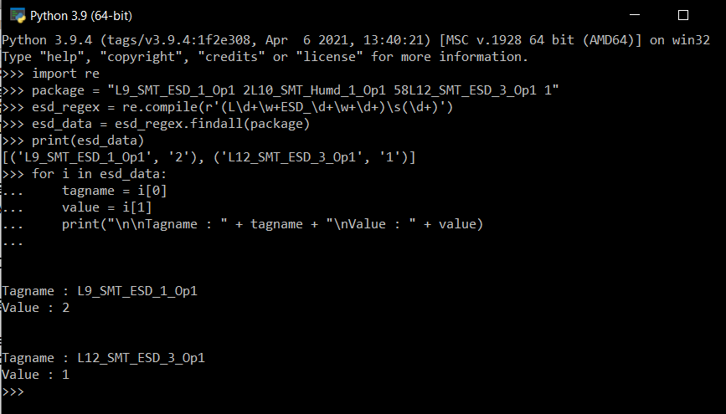
ESD Regular Expression

Slide 6
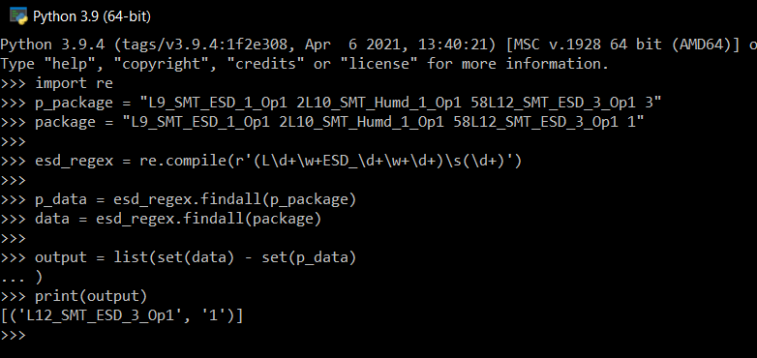
Obtain different value from previous data
Example :
Finding only ESD value on python
p_package = “L9_SMT_ESD_1_Op1 2L10_SMT_Humd_1_Op1 58L12_SMT_ESD_3_Op1 3”
package = “L9_SMT_ESD_1_Op1 2L10_SMT_Humd_1_Op1 58L12_SMT_ESD_3_Op1 1”
previous package L12 ESD value is 3, updated value to 1
Output : [(‘L12_SMT_ESD_3_Op1’, ‘1’)]

